Slide 1
The Sámi in Finland

Slide 2
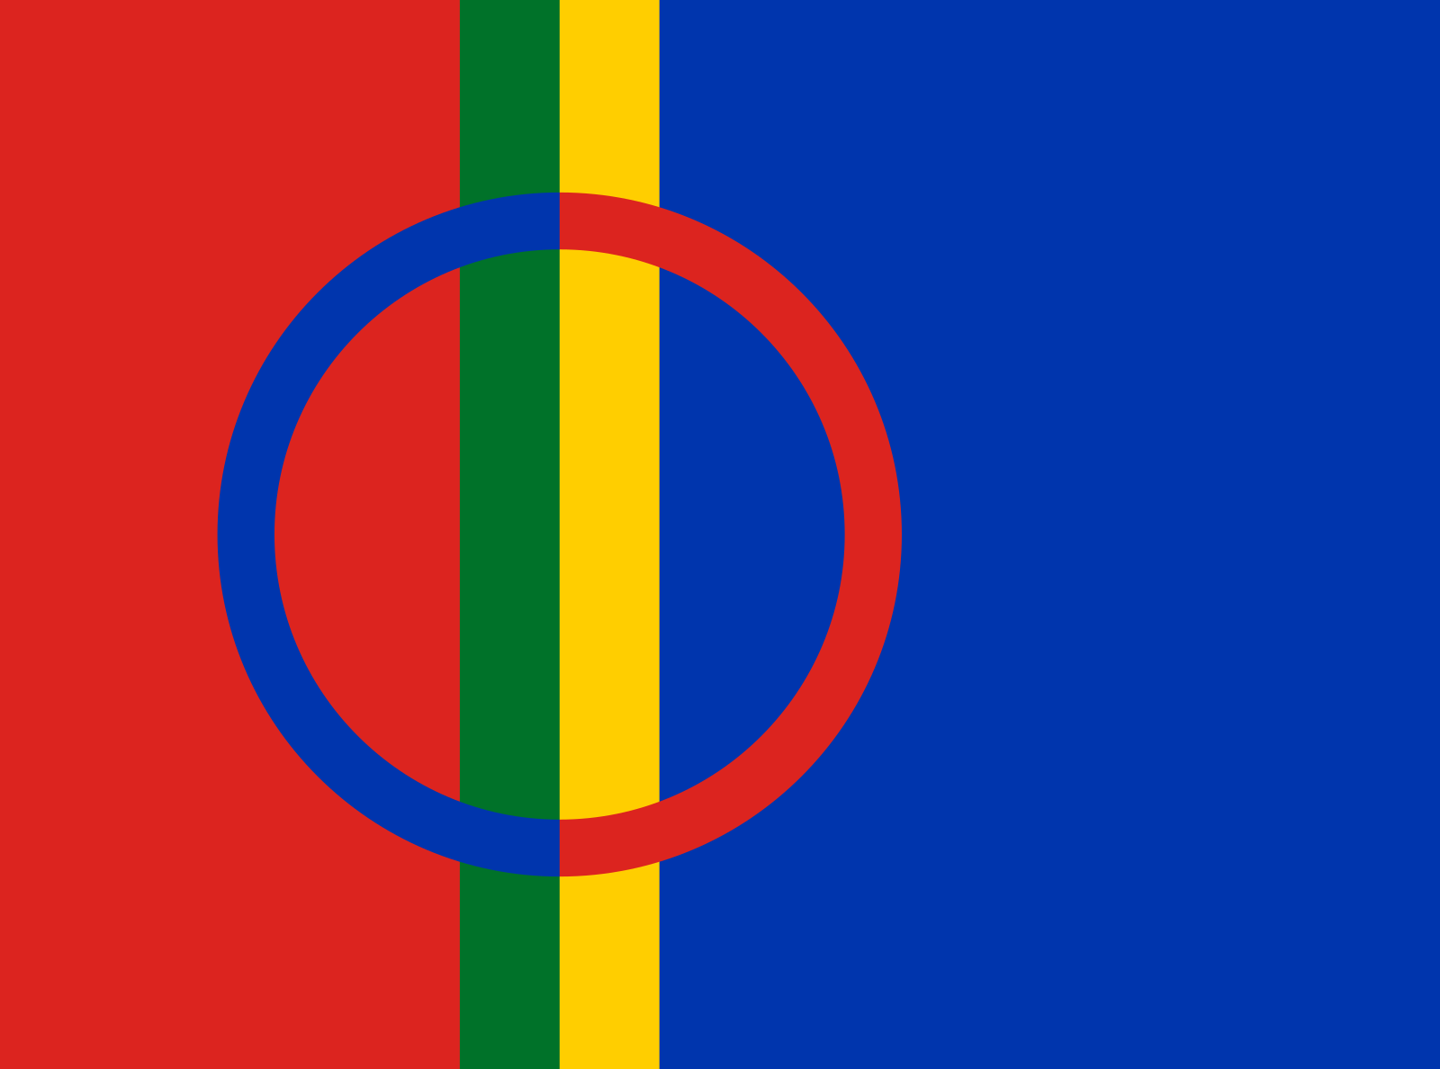
The Sámi in Finland
The Sámi are the only indigenous people in the European Union.
About 10,000 Sámi live in Finland.
Traditional Sámi livelihoods include reindeer husbandry, fishing and handicrafts.
Under the Constitution of Finland, the Sámi have the right to maintain and develop their own language and culture.
Source: Wikimedia Commons (PD)

Slide 3
11 December 2022
The Sámi in Finland speak
➢ North Sámi ➢ Inari Sámi ➢ Skolt Sámi.
The Sámi languages are official languages in the Sámi Homeland in the municipalities of Inari, Enontekiö and Utsjoki and in the northern part of Sodankylä.
Today, many Sámi live outside the Homeland, as a result of which the use of the languages has declined.
Efforts have been made to revitalise the languages through the language immersion of young children.

Slide 4
Discrimination against the Sámi
For generations, the authorities and the Church tried to integrate the Sámi into Finland’s majority population.
For example, speaking in their mother tongue could be prohibited from Sámi children.
The Sámi culture has been at risk of disappearing because of the discrimination.
Today, the Sámi are worried about the effects that mining, railway and other projects have on their traditional livelihoods.

Slide 5
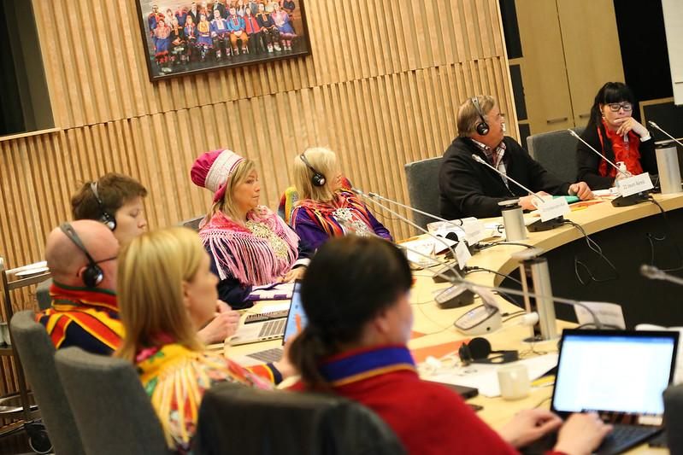
Sámi Parliament
The Sámi Parliament is an autonomous body of the Sámi.
The Parliament takes initiatives and issues statements on matters concerning the Sámi.
The authorities must negotiate with the Sámi Parliament on decisions that may affect the status of the Sámi.
The representatives (21) to the Sámi Parliament are elected every four years.
Source: Samediggi Sámi Parliament (Flickr.com)
(CC-BY-NC-SA 2.0)

Slide 6
Legal status of the Sámi
Although the rights of the Sámi are mentioned in the Constitution of Finland, there are still deficiencies in their status.
Finland has not ratified the international ILO Convention 169 guaranteeing the rights of indigenous peoples.
For example, the UN Human Rights Committee has reprimanded the State of Finland for violating the right to self-determination of the Sámi.
The issue of who can vote in the elections for the Sámi Parliament has led to disagreements.

