Slide 1
The Roma in Finland

Slide 2

Finnish Roma
The Roma are one of the national minorities in Finland.
More than 10,000 Roma live in Finland.
The Roma culture emphasises cleanliness, good manners and respect for old people, which is visible in their dress codes, among other things.
The Constitution of Finland guarantees the right to foster their language and culture to the Roma.
The Roma National Day is celebrated on 8 April.
Source: Wikimedia Commons (PD)

Slide 3

The Romani language
The mother tongue of the majority of the Roma in Finland is Finnish.
The number of people who speak the original Romani language has declined and most of them are elderly.
Efforts have been made to improve the position of the language for example by providing instruction in the Romani language in comprehensive schools.
Today, it is possible to complete a test in the Romani language as part of the matriculation examination and it can be studied as a minor subject at the University of Helsinki.

Slide 4
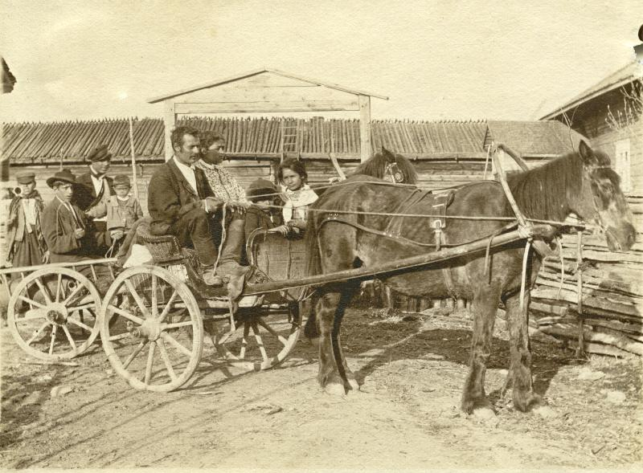
History of the Roma
It is believed that the Roma originate from India, from where they began to wander towards Europe in the Middle Ages.
The first Roma arrived in Finland in the 1500s.
For centuries, the Roma had a wandering lifestyle working, for example, as craftsmen and traders.
After the mid-1900s, the majority of the Roma in Finland have settled to live in towns and cities.
However, the Roma culture has maintained its original characteristics.
Source: Museum of Central Finland (Finna.fi) (CC-BY ND 4.0)

Slide 5
Discrimination of the Roma
The authorities and the Church discriminated against the Roma for centuries.
In the 1600s and 1700s, efforts were made to expel the Roma from Finland and church ceremonies were prohibited from them.
From the 1880s, efforts were made to integrate them into the majority population.
In the past few decades, the government has begun to take a more favourable attitude to the Roma culture.
However, discrimination and prejudices against the Roma are still common.
For example, the police and security guards have performed ethnic profiling of the Roma.

Slide 6
Societal status of the Roma
Discrimination and the disappearance of the traditional livelihoods have weakened the societal status of the Roma.
The level of education and the employment rate of the Roma are lower than in the population on average.
For example, it is difficult for persons with a Roma background to find a place to live and a job.
Many Roma find that the surrounding society does not understand or value their culture.

