Slide 1
Drafting the budget for an imaginary municipality
Planning of the budget for own imaginary municipality in small groups

Slide 2
Welcome to create your own imaginary municipality!
Finland has just over 300 municipalities, the task of which is to organise basic public services to their residents.
The activities of the municipality are guided by political decision-making, for which the municipal council is responsible. The members of the council are elected in municipal elections organised every four years.
In this assignment, you will operate in your own imaginary municipality. As its decision-makers, you will make decisions on funding in the municipality.
  First task: Form groups of 3–4 people according to the teacher’s instructions.

Slide 3
Size of the imaginary municipality
Your imaginary municipality is medium-sized, so it has 18,000 residents.
  The largest and smallest municipalities in Finland (link in Finnish)
Second task: Invent a name for your imaginary municipality!
Third task: Find out how many residents your own municipality has.

Slide 4
What does the municipality do?
Municipalities organise statutory basic public services to their residents.
Fourth task: What kind of different services organised by municipalities do you know?
The most important basic public services are
  education and early childhood education and care
  culture, youth, library and sports services
  technical services, which include services such as infrastructure and water and waste management

Slide 5
Did you know?
Interactive map of wellbeing services counties (link in Finnish)
Previously, the tasks of municipalities also included social and health services and fire and rescue services.
From the beginning of 2023, these services become the responsibility of wellbeing services counties. There are a total of 21 wellbeing services counties.

Slide 6

Where does the municipality get money from?
The municipality needs money to organise basic public services. Basic public services are mainly funded with municipal taxation, government contributions and fees charged for the services.
The activities of the municipality are guided by a budget that is drawn up for a minimum of three years.
The budgeting of the municipality, in other words, the plan for the use of the municipality's money affects all of the municipality’s activities.

Slide 7
Just a minute... Why are we learning something like this?
There is the Convention on the Rights of the Child, which defines the most important rights of children. The provisions of the Convention on the Rights of the Child have been recorded in the Constitution of Finland (link in Finnish).
For example, the Convention mentions that children must be allowed to express their views in matters affecting children (section 12). Children also have the right to express their opinion (section 13).
Next, you will be able to act as the budget planners in your imaginary municipality. In the task, you will need cooperation skills and mathematics. Remember to reflect on your choices carefully on behalf of all residents of the municipality.

Slide 8
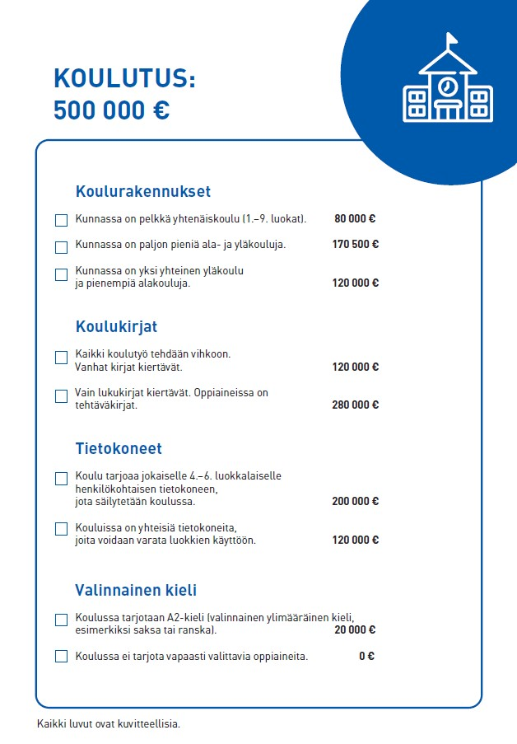
Let's start! Education
You will get the first form, which is about education. Your task is to make different decisions regarding the topic.
At the top of the form, you will see how much money is available for the plan.
The form has different subheadings. One option must be selected under each subheading. Tick the option you have selected
NB! All the amounts used in the assignment are fictitious.

Slide 9
Fifth task: Plan the budget for education. Your teacher will give you the form for the budget plan.
Remember to keep an eye on the total of the amount you have used because the budget cannot be exceeded. However, the budget cannot remain significantly below the determined sum, so do not only try to find the cheapest solution.
Think carefully how you can find an overall solution that will work as well as possible in your municipality.

Slide 10
Drafting the budget for an imaginary municipality continues

Slide 11
Budgeting for the basic public services
Next, you will receive the rest of the forms needed for planning the budget for your municipality:
  Infrastructure
  Leisure activities.
With each form, do the same as with the first form, Education. Reflect on your choices carefully and make sure the money will be enough. When each group has finished the task, go through the choices made by the groups with the teacher.
NB! You do not need to pay attention the Project funding form yet.

Slide 12
Project funding
Your municipality has been granted project funding! This project funding will be directed for children and young people to use.
The projects are smaller projects external to the budget, and separate funding for them can be applied for from the State.
Project funding can be used for example to fund individual procurements, different kinds of trips or other activities in the municipality.

Slide 13
Plan the project funding in your imaginary municipality
Your municipality receives a funding of EUR 30,000 for a variety of projects for children and young people. With the help of the following slide, think about what your municipality will use the funding for.
Mark the choices you made in the form Project funding. You can select matters from many different categories as long as you do not exceed the budget.
NB! All the amounts used in the assignment are fictitious.

Slide 14
Education | Price
A free snack will be served to every pupil in schools | EUR 10,000
A favourite food day will be organised in schools once a month. | EUR 3,000
New and different sports equipment will be acquired to schools. | EUR 8,500
In addition to computers, topical digital equipment will be acquired to schools (e.g., robotics). | EUR 10,000
A large number of instruments for bands will be acquired to schools. | EUR 9,000
Equipment in accordance with pupils’ wishes will be acquired to schools to be used during recess. | EUR 10,000
Pull-up bars will be installed to classrooms in schools. | EUR 1,000
Soft sofas will be acquired to the common areas in schools. | EUR 5,500
Books, comics and board games according to pupils’ wishes will be acquired to schools. | EUR 1,500
Leisure | Fee
Schools will organise a club that pupils have wished, an external instructor will be acquired for the club. | EUR 4,000
Free theatre performances will be organised to children and young people. | EUR 4,500
A pool table will be acquired to the youth centre. | EUR 2,500
VR glasses and VR games will be acquired to the library to be used freely. | EUR 1,500
A free concert will be organised for children and young people, the performed of which they can wish themselves. | EUR 15,000
Infrastructure | Price
A high pyramid net will be acquired to the playground. | EUR 8,000
A skateboard ramp will be acquired to the centre. | EUR 7,000
A trampoline built on the ground will be acquired to the playground. | EUR 4,500
A large parkour course will be built to the playground. | EUR 15,000
A new disc golf course will be built to the playground. | EUR 8,000
A climbing wall will be built to a wall in the school or sports hall. | EUR 4,000
Project funding: EUR 30,000

Slide 15
Summary
Congratulations, you have completed the planning of the budget for your municipality!
What kind of acquisitions did you make in project funding?
What was it like to make decisions on project funding?
How did the cooperation inside the group work in decision-making? What did you do if you did not agree?
Why is it important to also take children into account in decision-making?

